Slide 1

North-Point Software Production Company
Presented by :Nikroshitha

Slide 2
Executive Summary
Objective: North Point Software Listing Company aims to enhance marketing strategies and customer acquisition through targeted mailing campaigns.
Approach: Leveraging predictive modeling techniques to optimize resource allocation, increase sales, and expand the customer base.
Dataset: 2000 customer records evenly split between purchasers and non-purchasers, with attributes including source channels, purchase frequency, and spending amount.
Preferred Models: Logistic regression for customer classification with 81.4% test accuracy. Linear regression for spending prediction with a Mean Absolute Error of 92.06 on holdout data.
Estimated Gross Profit: $1,598,075 for 180,000 customers.
Gain Chart: Illustrates the effectiveness of predictive models, highlighting high-profit customer segments.
Enhancements: Data preprocessing, attribute relevancy exploration, and multivariate analysis for optimized marketing strategies.

Slide 3
Introduction
North Point Software Listing Company
North Point is a software listing firm preparing to launch a collection of games and educational software through mailing.
Strategy: Expand customer base by joining a consortium of listing firms matching their background.
A pool created where each firm supplies customers for a mailing experiment.

Slide 4
Business Opportunity
Goal: Maximize profitability and expand customer base through targeted marketing.
Utilize predictive modeling and data analysis to enhance mailing campaign effectiveness.
Balance cost-effectiveness and revenue generation for sustainable growth in the software market.

Slide 5
Business Goal
Enhance
Enhance mailing campaign effectiveness with machine learning models.
Classify
Model 1: Classify prospects as purchasers or non-purchasers based on attributes like acquisition source and purchase frequency.
Predict
Model 2: Predict spending amount of potential purchasers for targeted marketing and revenue optimization.

Slide 6
Data Preprocessing
Checked for zero values in the dataset
Checked for missing values

Slide 7
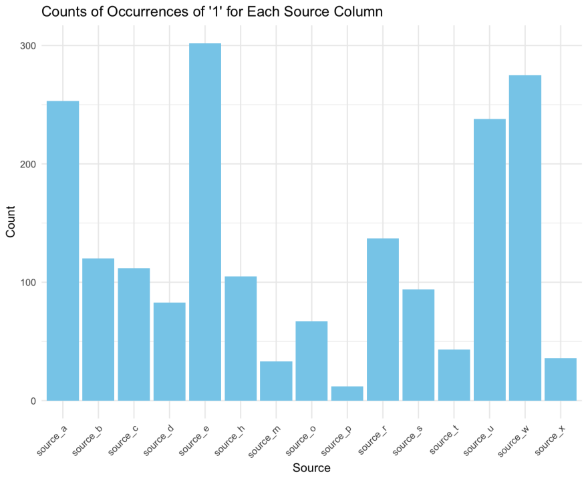
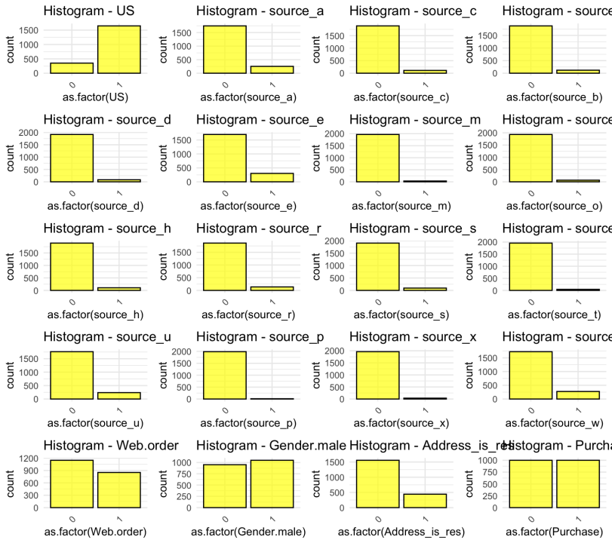
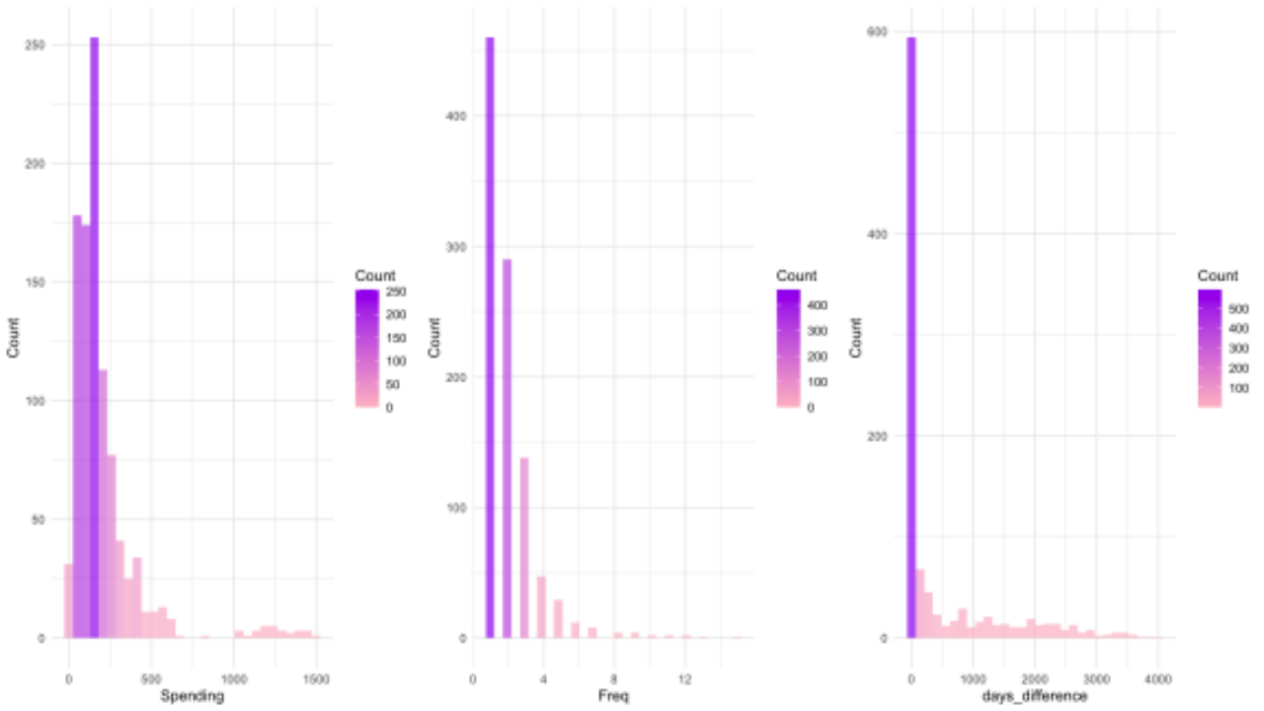
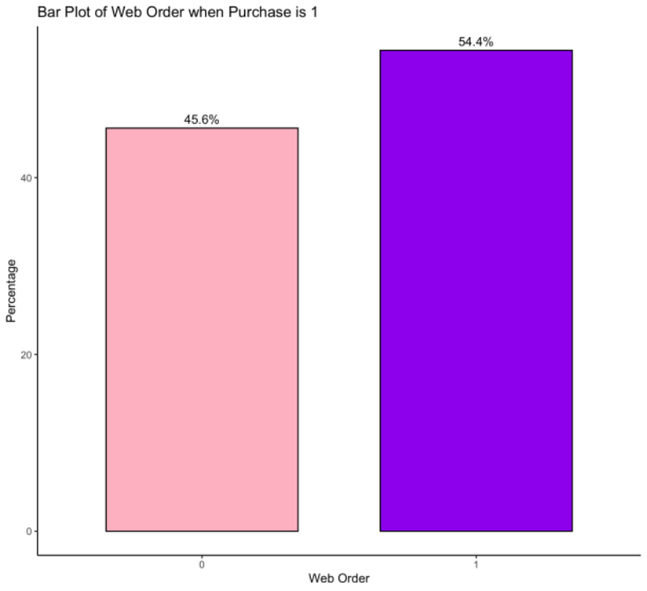
Plots

Slide 8
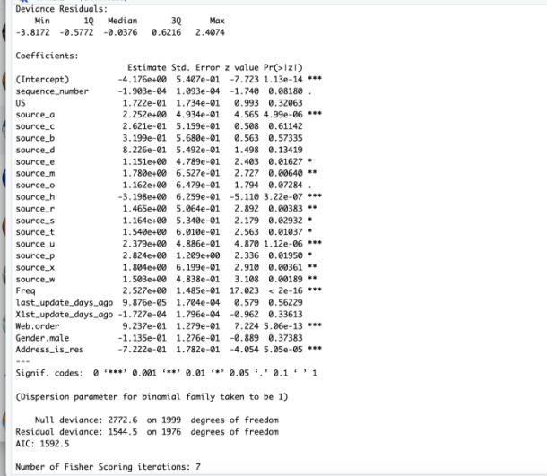
Feature Importance

Slide 9
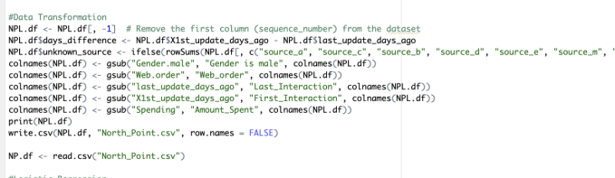
Data Transformation

Slide 10
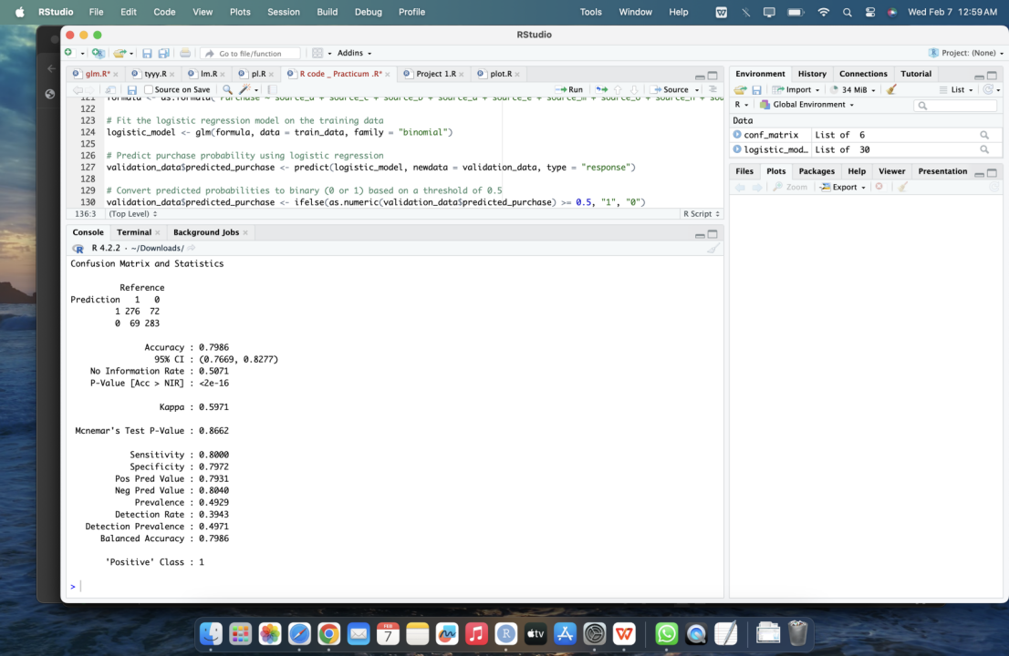
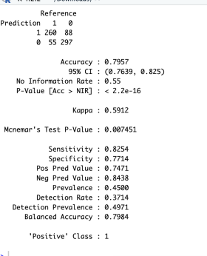
Goal 1
To classify customers as purchasers or non-purchasers with the target attribute being Purchase
Logistic Regression

Slide 11
Model Comparison
 | Logistic Regression | Classification Tree | KNN Model
Accuracy | 0.7957 | 0.7829 | 0.7729
Sensitivity | 0.8254 | 0.7722 | 0.7838

Slide 12
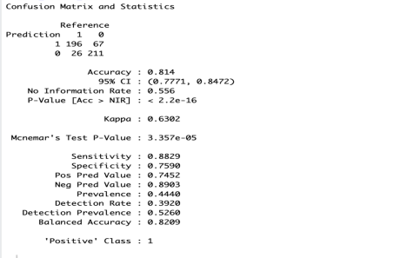
HOLDOUT for selected model – Logistic Regression

Slide 13
Regression Model - Goal 2
Model | MAE
Linear Regression | 116.35
Regression Tree | 76.404

Slide 14
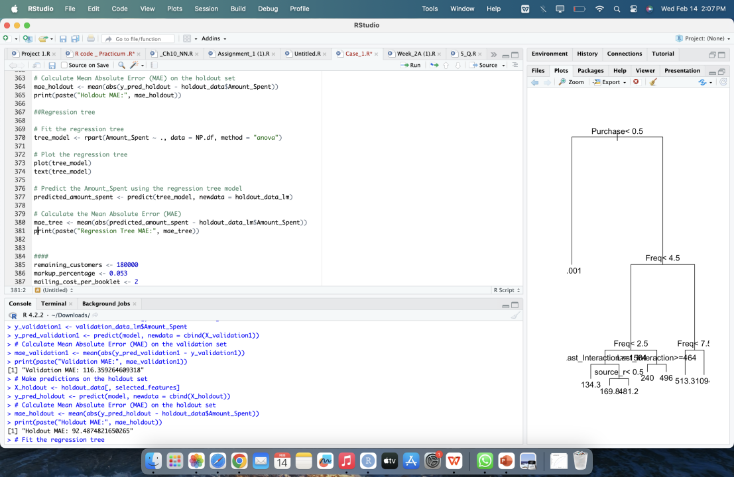
Holdout data MAE – Linear regression
In comparing linear regression and regression tree models for estimating `Amount_Spent`, the regression tree model demonstrated lower Mean Absolute Error (MAE), suggesting better predictive accuracy. However, despite this superior performance, the decision to retain linear regression was based on its interpret-ability, ease of implementation, and alignment with business objectives.

Slide 15
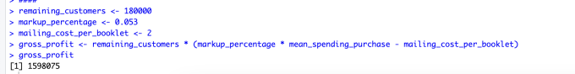
Gross Profit Estimation

Slide 16
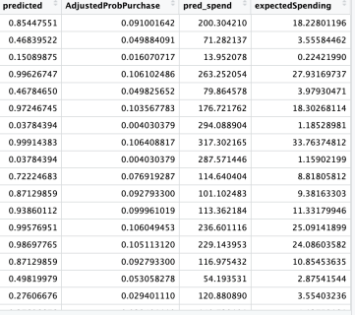
Business requirement

Slide 17
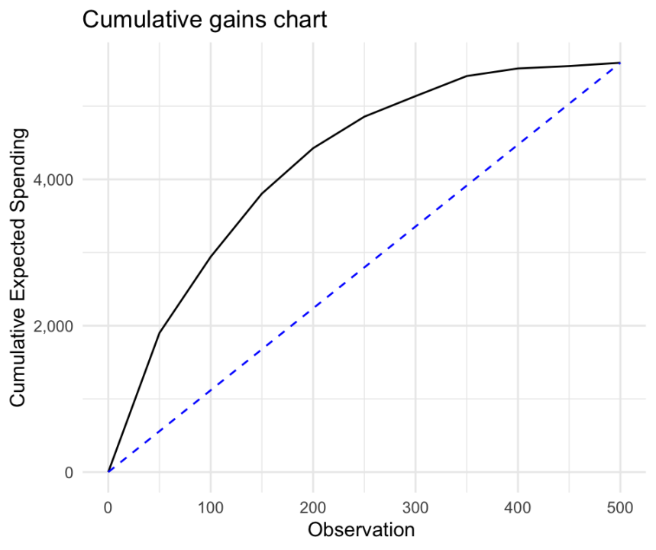
Gain Chart
The gain chart shows how well the predictive model works, indicating that targeting the top 350 customers baseline can lead to high profits

Slide 18

Summary
Goal 1 – Logistic Regression
Goal 2 – Linear regression
Gross Profit : 1598075
Gain Chart : 350 Customers Baseline
Business Recommendation :Continuously evaluating and refining mailing campaigns, conducting cost-benefit analyses, and investing in data quality and analytics are essential strategies for North-Point to ensure marketing effectiveness and maximize ROI in the competitive software market.

